Slide 1
Java web - Servlet - section 01
Vo Hoang Long - TBV (Technical Gorup)

Slide 2
Agenda
Servlet
Servlet Container
Server: Web vs Application
Servlet Life Cycle
Servlet Request
ServletDispatcher

Slide 3
What is a Servlet?
Servlet can be described in many ways, depending on the context.
Servlet is a technology which is used to create a web application.
Servlet is an API that provides many interfaces and classes including documentation.
Servlet is an interface that must be implemented for creating any Servlet.
Servlet is a class that extends the capabilities of the servers and responds to the incoming requests. It can respond to any requests.
Servlet is a web component that is deployed on the server to create a dynamic web page.

Slide 4
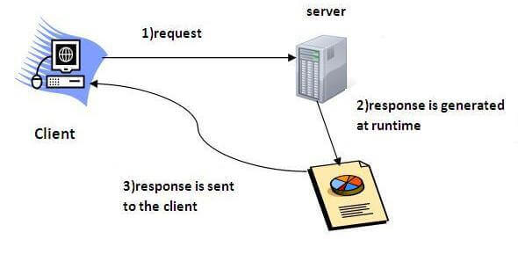
What is a Servlet?

Slide 5
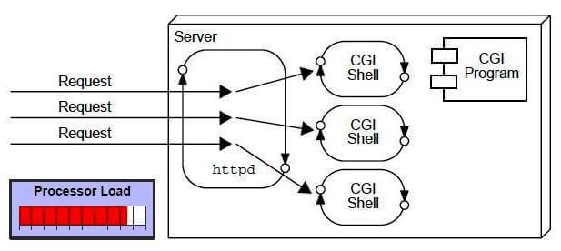
CGI (Common Gateway Interface)
CGI technology enables the web server to call an external program and pass HTTP request information to the external program to process the request. For each request, it starts a new process.

Slide 6
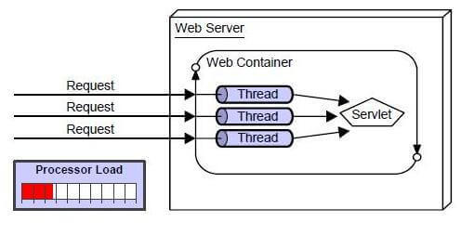
Servlet

Slide 7
Servlet
There are many advantages of Servlet over CGI. The web container creates threads for handling the multiple requests to the Servlet. Threads have many benefits over the Processes such as they share a common memory area, lightweight, cost of communication between the threads are low. The advantages of Servlet are as follows:
Better performance: because it creates a thread for each request, not process.
Portability: because it uses Java language.
Robust: JVM manages Servlets, so we don't need to worry about the memory leak, garbage collection, etc.
Secure: because it uses java language.

Slide 8
Servlet Container
It provides the runtime environment for JavaEE (j2ee) applications. The client/user can request only a static WebPages from the server. If the user wants to read the web pages as per input then the servlet container is used in java.
The servlet container is the part of web server which can be run in a separate process. We can classify the servlet container states in three types:
Standalone: It is typical Java-based servers in which the servlet container and the web servers are the integral part of a single program. For example:- Tomcat running by itself
In-process: It is separated from the web server, because a different program runs within the address space of the main server as a plug-in. For example:- Tomcat running inside the JBoss.
Out-of-process: The web server and servlet container are different programs which are run in a different process. For performing the communications between them, web server uses the plug-in provided by the servlet container.

Slide 9
Servlet Container
The Servlet Container performs many operations that are given below:
Life Cycle Management
Multithreaded support
Object Pooling
Security etc.

Slide 10
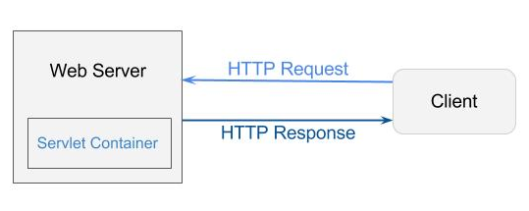
Servlet Container

Slide 11
Server: Web vs. Application
Server is a device or a computer program that accepts and responds to the request made by other program, known as client. It is used to manage the network resources and for running the program or software that provides services.
There are two types of servers:
Web Server
Application Server

Slide 12
Server: Web vs. Application
Web Server
Web server contains only web or servlet container. It can be used for servlet, jsp, struts, jsf etc. It can't be used for EJB.
It is a computer where the web content can be stored. In general web server can be used to host the web sites but there also used some other web servers also such as FTP, email, storage, gaming etc.
Examples of Web Servers are: Apache Tomcat and Resin.

Slide 13
Server: Web vs. Application
Web Server Working
It can respond to the client request in either of the following two possible ways:
Generating response by using the script and communicating with database.
Sending file to the client associated with the requested URL.
Important points
If the requested web page at the client side is not found, then web server will sends the HTTP response: Error 404 Not found.
When the web server searching the requested page if requested page is found then it will send to the client with an HTTP response.
If the client requests some other resources then web server will contact to application server and data is store for constructing the HTTP response.

Slide 14
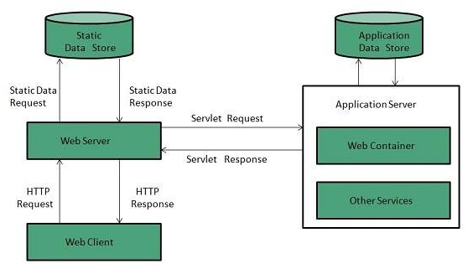
Server: Web vs. Application

Slide 15
Server: Web vs. Application
Application Server
Application server contains Web and EJB containers. It can be used for servlet, jsp, struts, jsf, ejb etc. It is a component based product that lies in the middle-tier of a server centric architecture.
It provides the middleware services for state maintenance and security, along with persistence and data access. It is a type of server designed to install, operate and host associated services and applications for the IT services, end users and organizations.
The Example of Application Servers are:
JBoss: Open-source server from JBoss community.
Glassfish: Provided by Sun Microsystem. Now acquired by Oracle.
Weblogic: Provided by Oracle. It more secured.
Websphere: Provided by IBM.

Slide 16
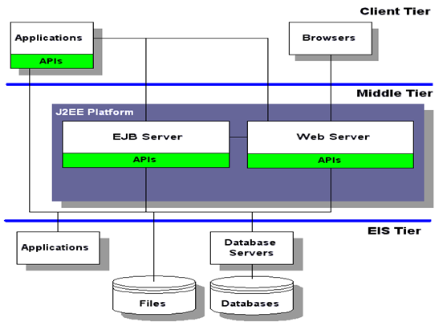
Server: Web vs. Application

Slide 17
Life Cycle of a Servlet (Servlet Life Cycle)
The web container maintains the life cycle of a servlet instance. Let's see the life cycle of the servlet:
Servlet class is loaded.
Servlet instance is created.
init method is invoked.
service method is invoked.
destroy method is invoked.
There are three states of a servlet: new, ready and end. The servlet is in new state if servlet instance is created. After invoking the init() method, Servlet comes in the ready state. In the ready state, servlet performs all the tasks. When the web container invokes the destroy() method, it shifts to the end state.

Slide 18
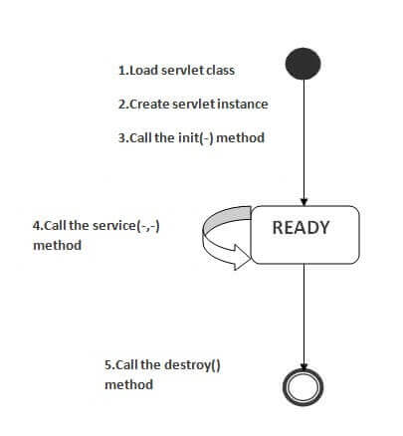
Life Cycle of a Servlet (Servlet Life Cycle)

Slide 19
ServletRequest Interface
An object of ServletRequest is used to provide the client request information to a servlet such as content type, content length, parameter names and values, header informations, attributes etc.

Slide 20
RequestDispatcher in Servlet
The RequestDispatcher interface provides the facility of dispatching the request to another resource it may be html, servlet or jsp. This interface can also be used to include the content of another resource also. It is one of the way of servlet collaboration.
There are two methods defined in the RequestDispatcher interface.
public void forward(ServletRequest request,ServletResponse response)throws ServletException,java.io.IOException:Forwards a request from a servlet to another resource (servlet, JSP file, or HTML file) on the server.
public void include(ServletRequest request,ServletResponse response)throws ServletException,java.io.IOException:Includes the content of a resource (servlet, JSP page, or HTML file) in the response.

Slide 21
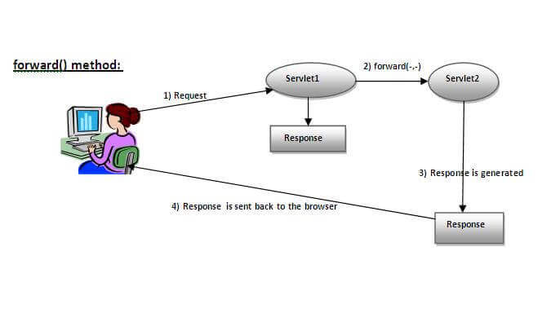
forward() method

Slide 22
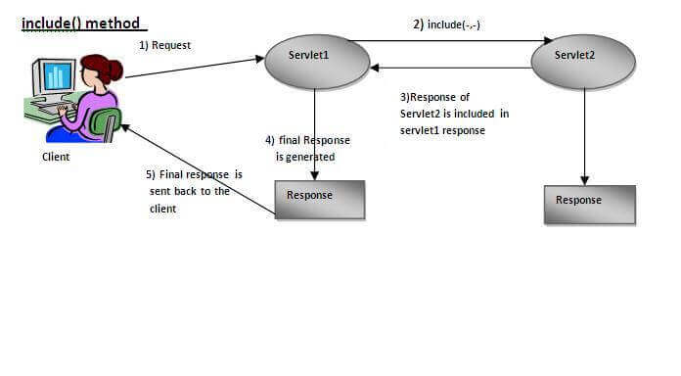
include() method

Slide 23
Example of RequestDispatcher interface
In this example, we are validating the password entered by the user. If password is servlet, it will forward the request to the WelcomeServlet, otherwise will show an error message: sorry username or password error!. In this program, we are cheking for hardcoded information. But you can check it to the database also that we will see in the development chapter. In this example, we have created following files:
index.html file: for getting input from the user.
Login.java file: a servlet class for processing the response. If password is servet, it will forward the request to the welcome servlet.
WelcomeServlet.java file: a servlet class for displaying the welcome message.
web.xml file: a deployment descriptor file that contains the information about the servlet.

Slide 24
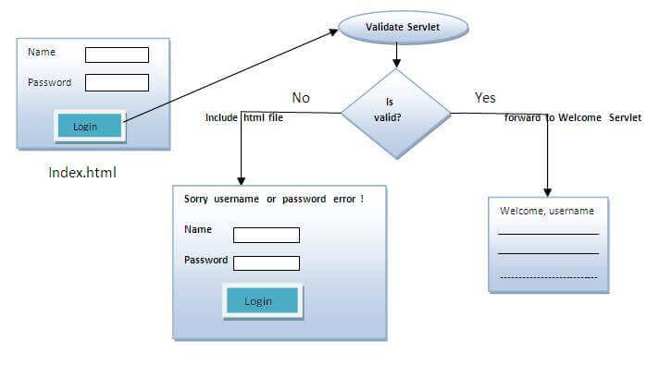
Example of RequestDispatcher interface

